Slide 1
Join

Slide 2
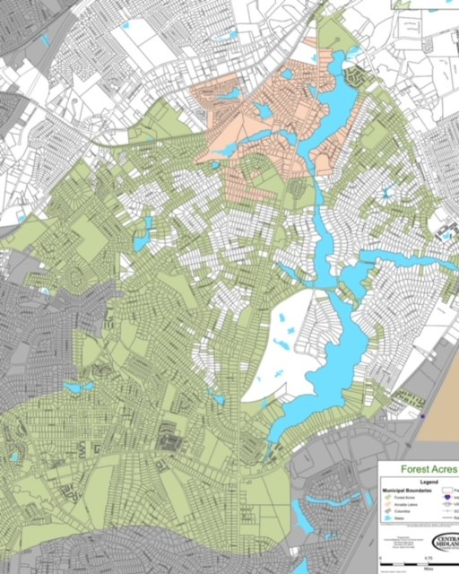
How Do I Join Forest Acres?
Through a process called annexation.
This is where unincorporated Richland County property is moved into the City of Forest Acres. Many of the white parcels on the map are properties within our city limits that can be annexed – some faster than others. These parcels are known as donut-holes.

Slide 3
Why Close Donut Holes?
By closing these “donut holes” through annexation, the City wishes to increase efficiencies, enhance services, and further improve the lives of current and future residents.
An increase in population would also benefit the City and would make Forest Acres eligible for larger State and Federal grants.
One collective voice vs. two governments.
Ensure our shared vision for the City moving forward.

Slide 4
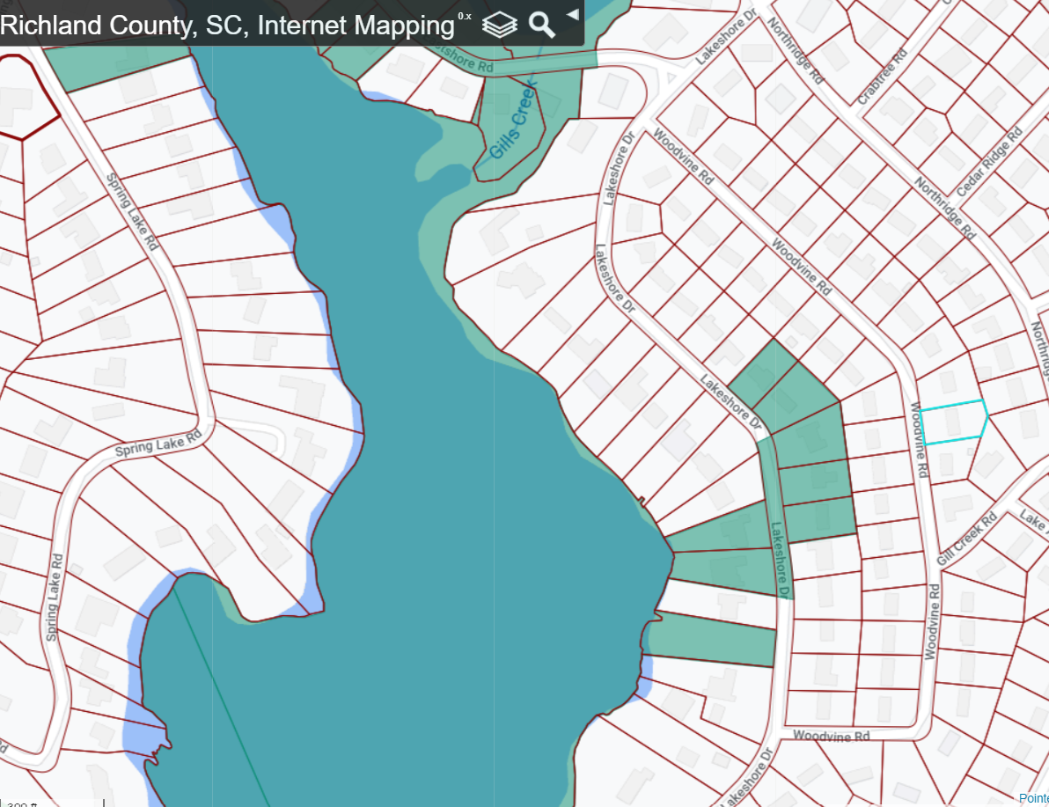
Can I Annex?
State Law only allows properties that are contiguous to our current borders to be annexed (or currently touching our boundary line).
The property must also not be part of another municipality.
Streets can come in together to speed up the process.

Slide 5
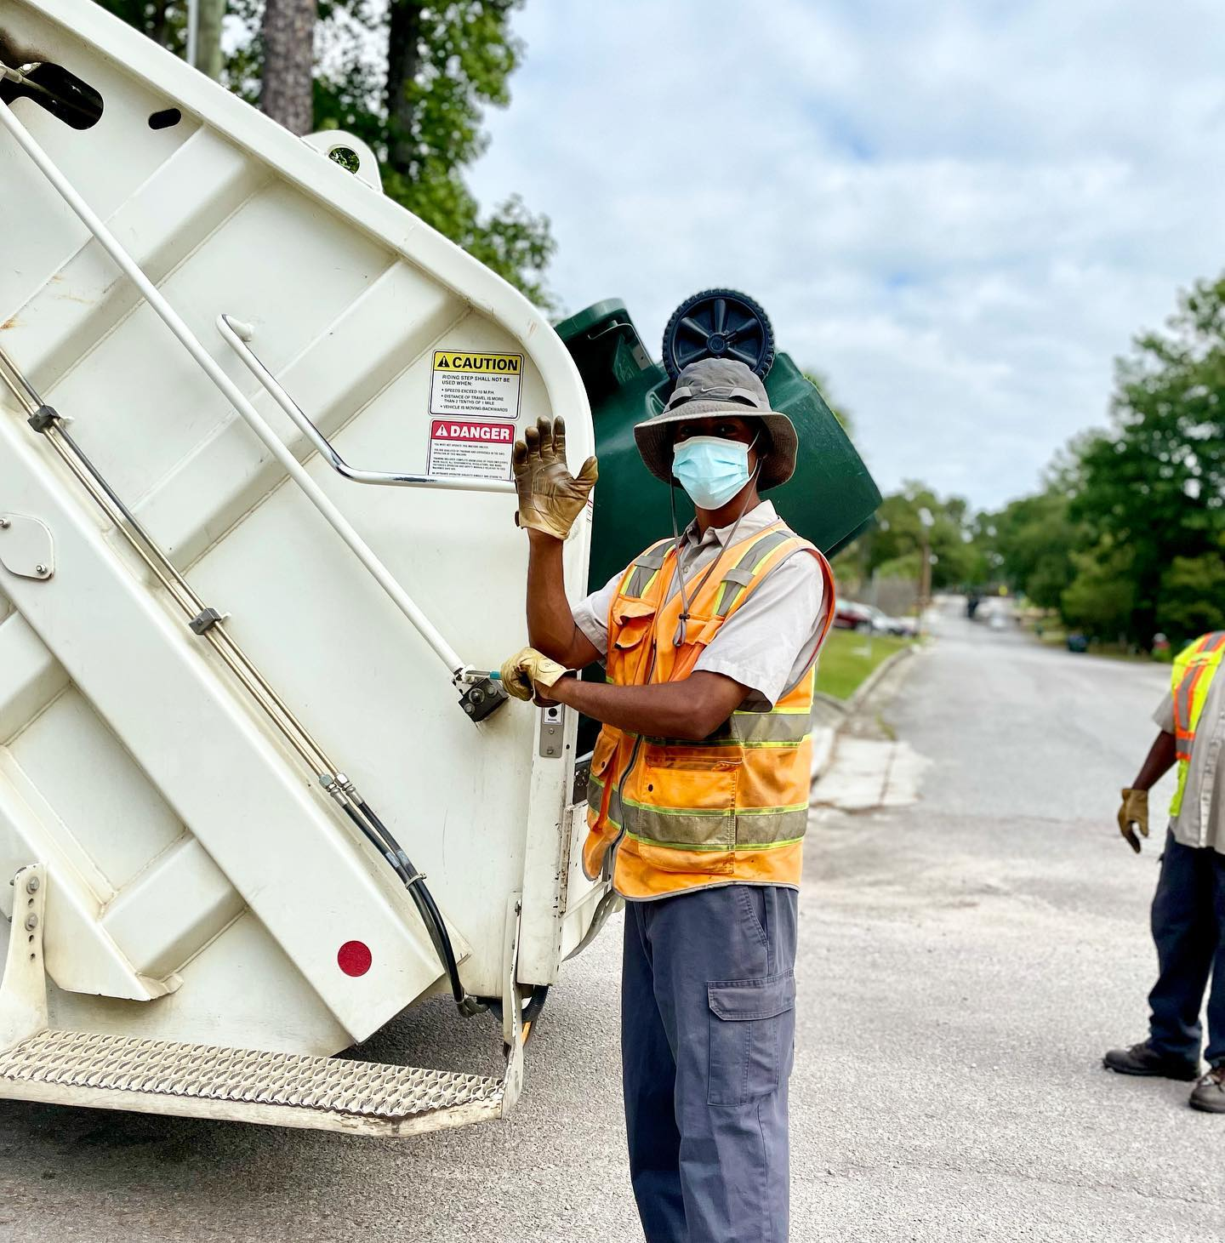
Benefits of Annexation
Free City services such as garbage, recycling, and yard debris collection and localized police protection.

Slide 6
Benefits of Annexation
Strong Voice in Government
Forest Acres City Council is comprised of four Council Seats and a Mayor. All positions are elected at-large. This means that every citizen has an opportunity to vote for each position.
As a current resident of Richland County, there is one Council person out of 11 total members that represents you.
As a resident of Forest Acres, you will enjoy a closer level of representation that affords a more personalized experience. The Mayor and Council regularly speak and meet with citizens to help resolve any issues they may have.

Slide 7
Benefits of Annexation
Potentially Lower Taxes and Fees
Many people believe that annexing into Forest Acres will increase their taxes. For most people this simply is not true.
Due to savings from Local Option Sales Tax Credit rebates and the fact that Forest Acres does not charge a garbage fee, most people will save money through annexation.
Data shows that any property with an assessed value at $375,000 or less will see a decrease in their taxes and fees.

Slide 8
Tax Comparison
Forest Acres
$1553.05
Richland County
$1744.77

Slide 9
Where Your Tax Money Goes

Slide 10
Annexation Process
If your property qualifies to annex, the process takes about three months.
A copy of your deed to City Hall
Month One: Application goes before Planning Commission
Month Two: First Reading at City Council Meeting
Month Three: Second Reading at City Council Meeting
Once approved, we take care of the rest and notify nearly 20 agencies of the change for you.

Slide 11
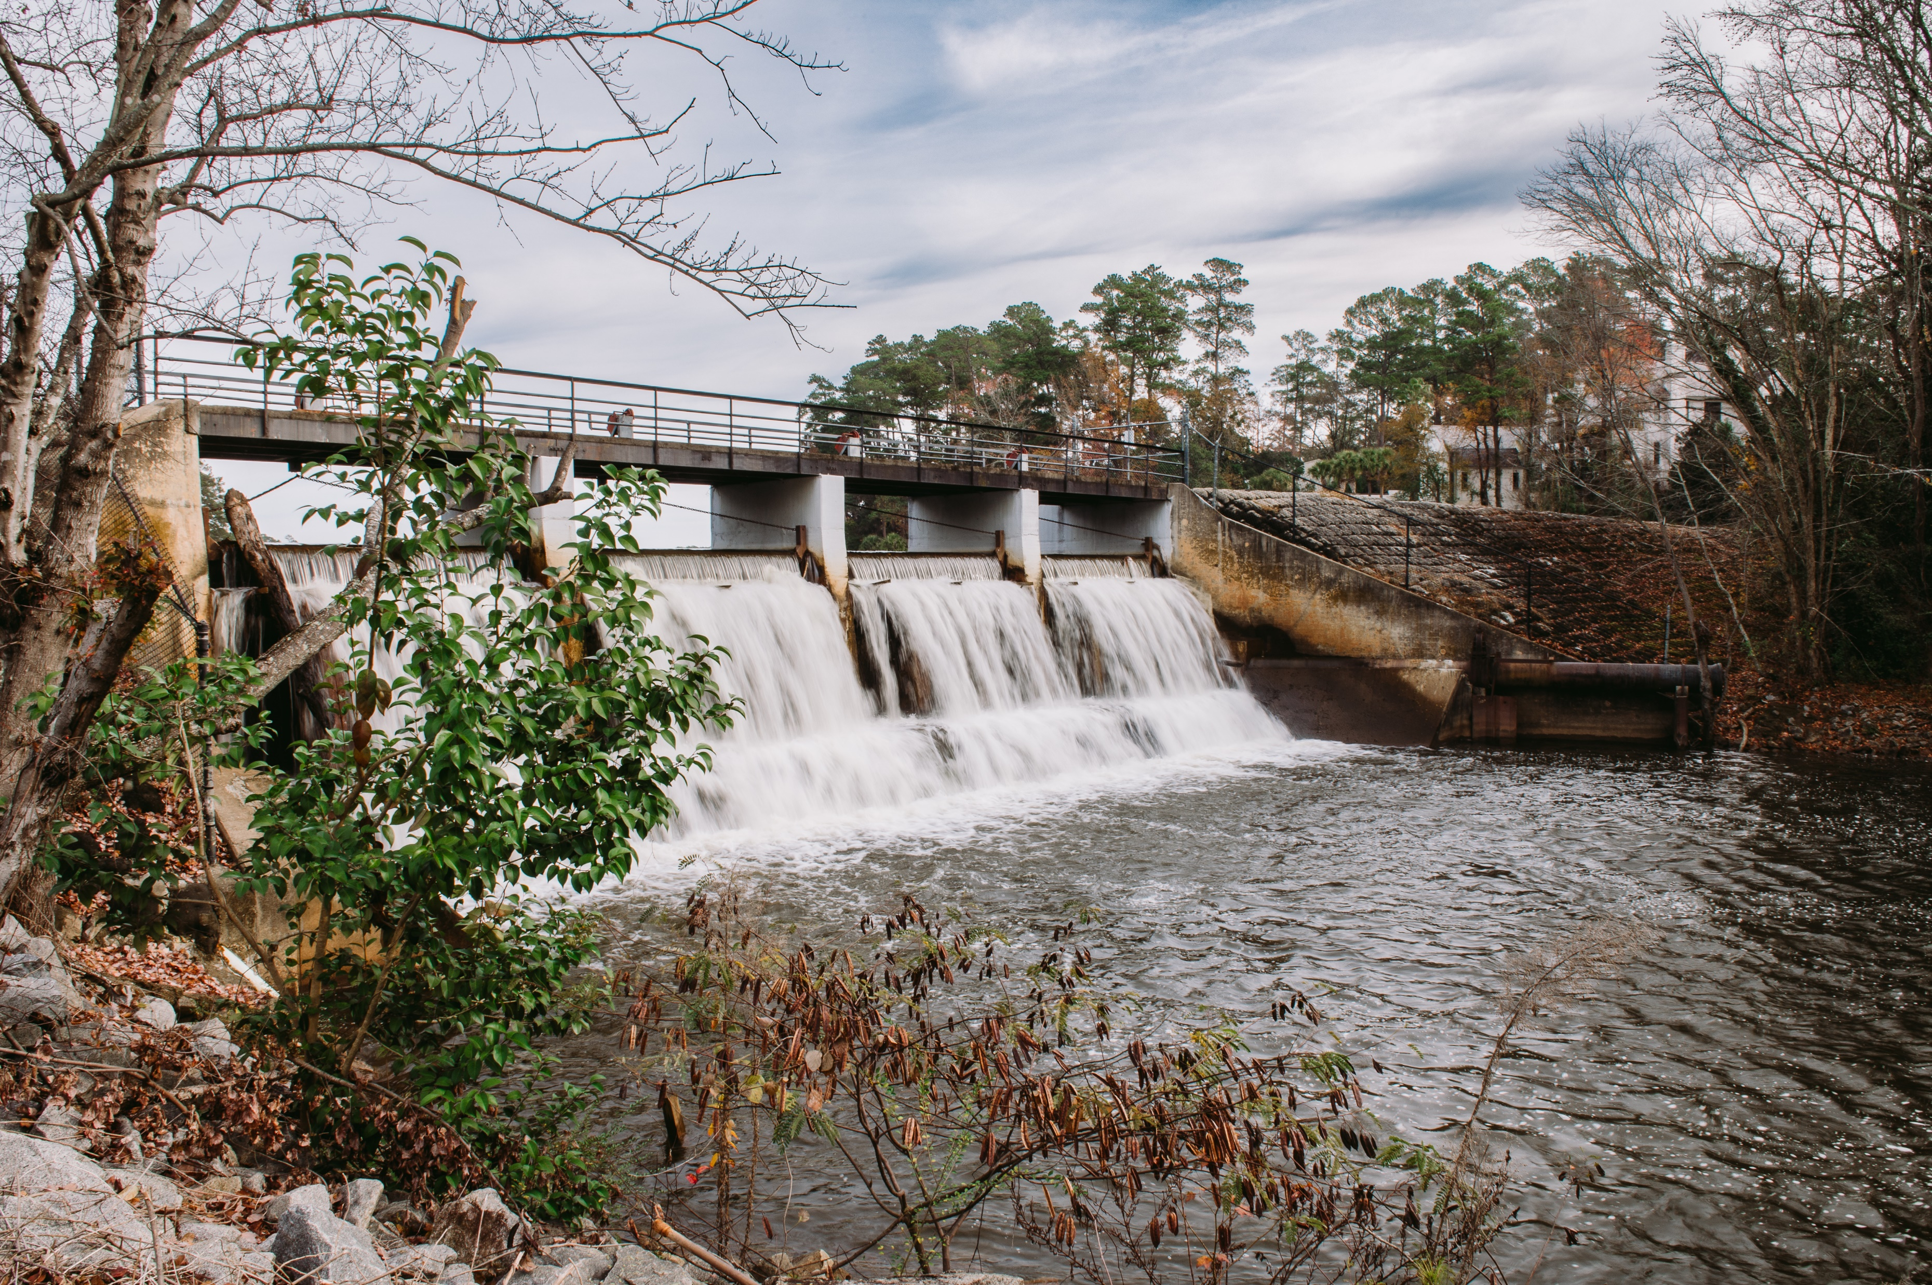
FAQ
Will my mailing address change? NO
Will my school district change? NO
Will there be a change in my water or sewer service? NO
Other questions?

